Slide 1

University Messaging System
Team Name : Panda
Team member : Naveen

Slide 2

University Messaging System
University Messaging System is a web-based communication system designed to help students and faculty to communicate with each other and with a group.
Users who require access to the system should be registering on the registration page. The request shall be forwarded to the Administrator for the final decision.
Approved users shall be able to login to the system, send, view and receive messages.

Slide 3
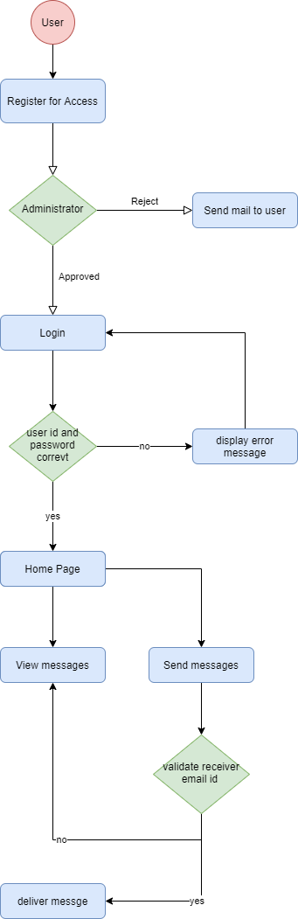
Activity Diagram

Slide 4
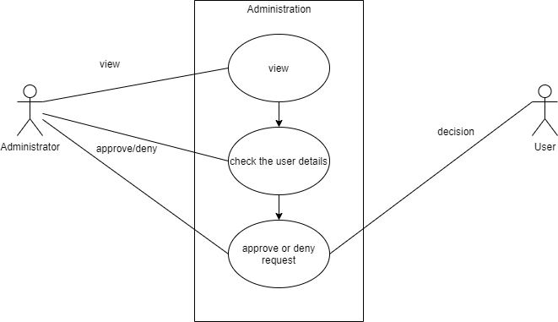
Use Case diagram Administration

Slide 5
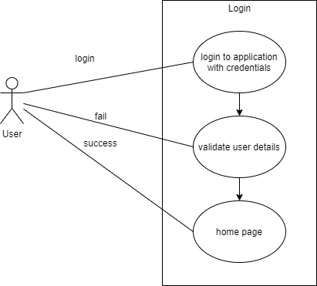
Use Case diagram Login

Slide 6
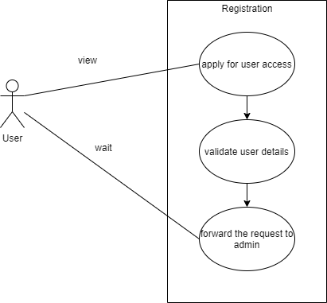
Use Case diagram Registration

Slide 7
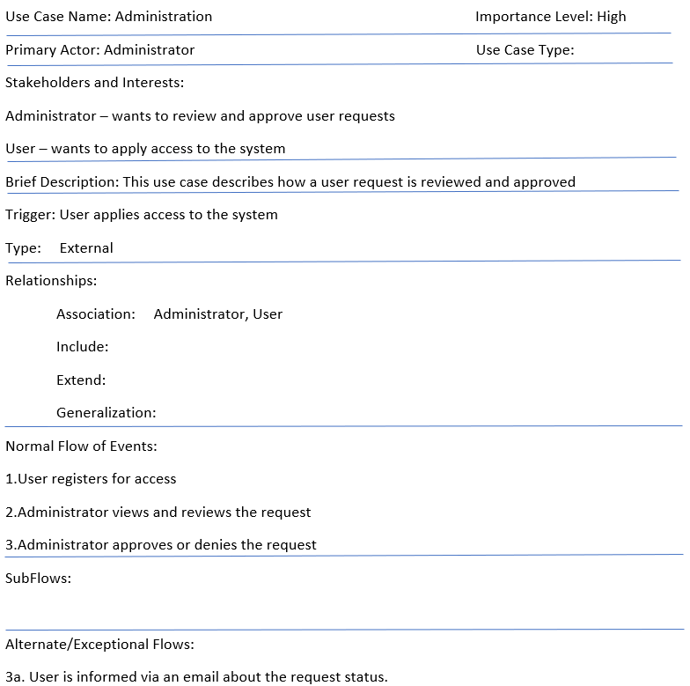

Use Case Description

Slide 8
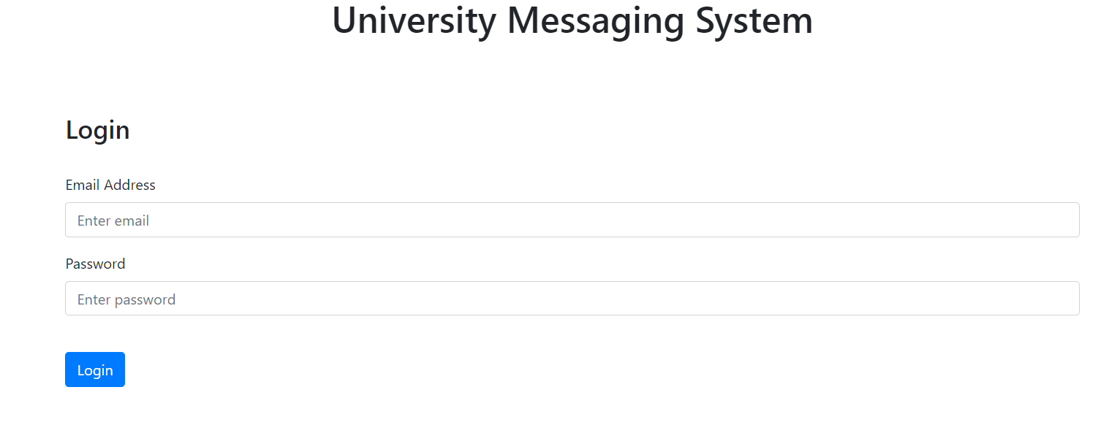
Login screen from the application

Slide 9
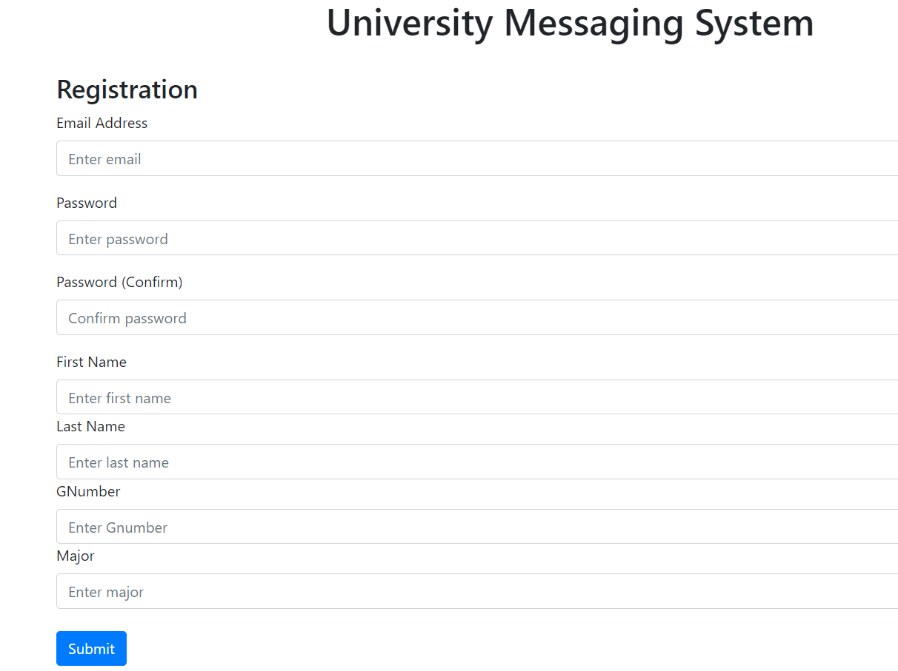
Registration screen from application

Slide 10
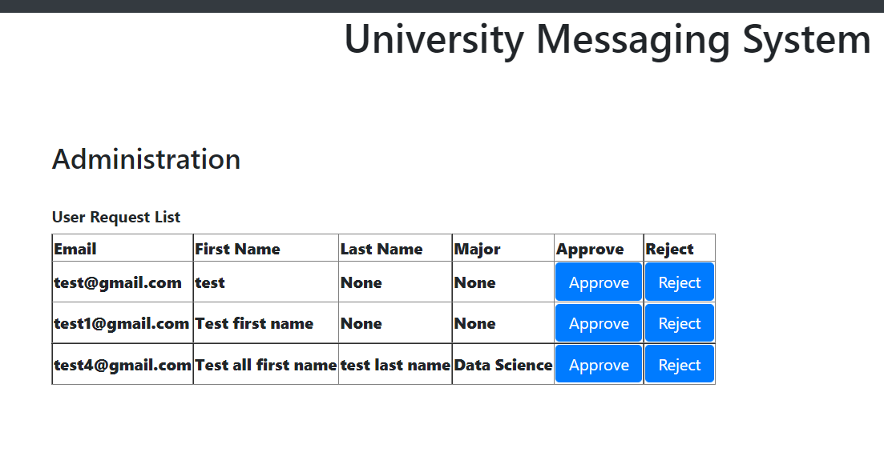
Administration screen from the application

Slide 11
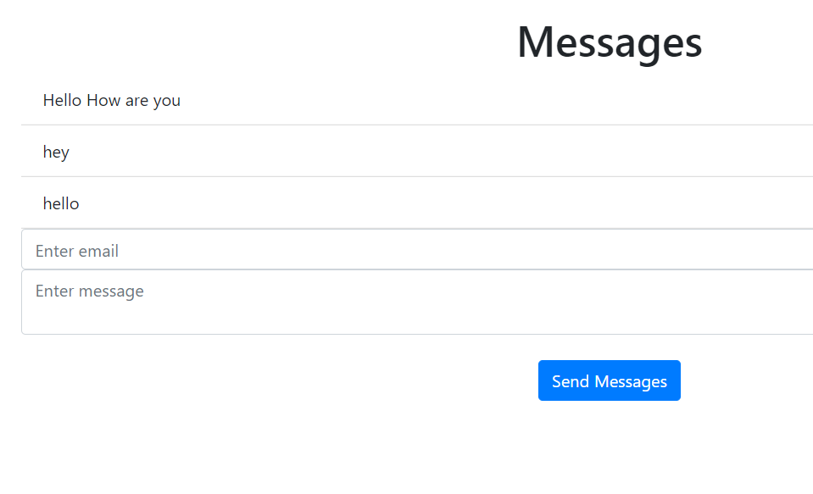
Messages Home Page

Slide 12
Implementation Details
UI – html
Database – SQL lite
Technology – Python, flask framework

